Slide 1

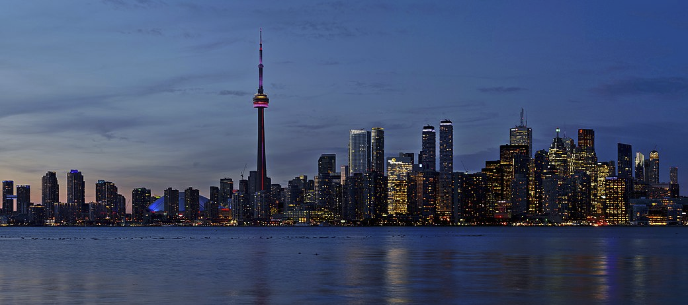


Crime and the city
Spatial planning for crime reduction

Slide 2
Complexity of city planning
Demographic makeup
Public venues
Crime
Complex correlation of public venues and crime, due to:
Known and unknown variables
Direct and indirect relation to crime.
Predicting the effect of interventions is equally complex
Time and costs are prohibitive for a trial and error approach.
Deterministic planning assumes complete knowledge
Solution:
Machine learning to support professional judgement?

Slide 3
Approach
City of Toronto (Ontario, Canada) as testcase
Data acquired from open sources:
Wikipedia and Coursera (location data), City of Toronto Open Data (crime data), Foursquare (Public venues).
Analysis using Python
Pandas, Numpy, Matplotlib, Geopy, SciKit-Learn
Qualitative analysis with k-means clustering, modeling with decision tree and SVM classifiers.

Slide 4
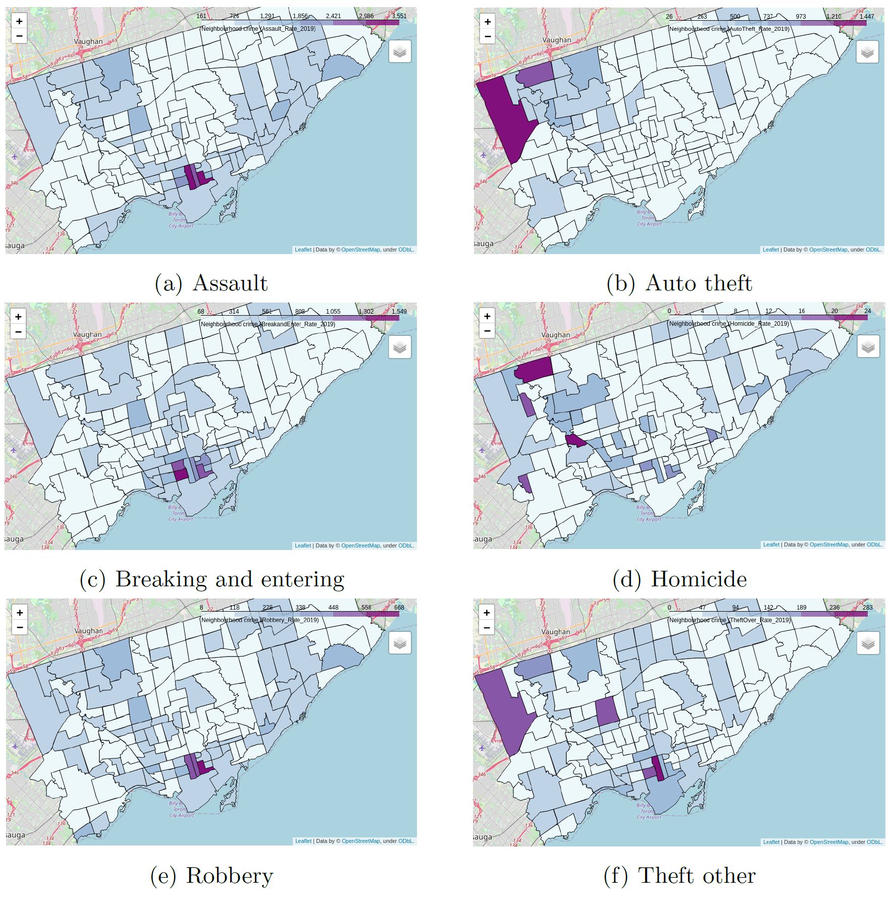
Spatial distribution of crime
Six individual crime categories
Worst crime areas (2019):
Harbour area
North-West Toronto
Least crime areas (2019):
East Toronto
Central Toronto (excluding harbour area)

Slide 5
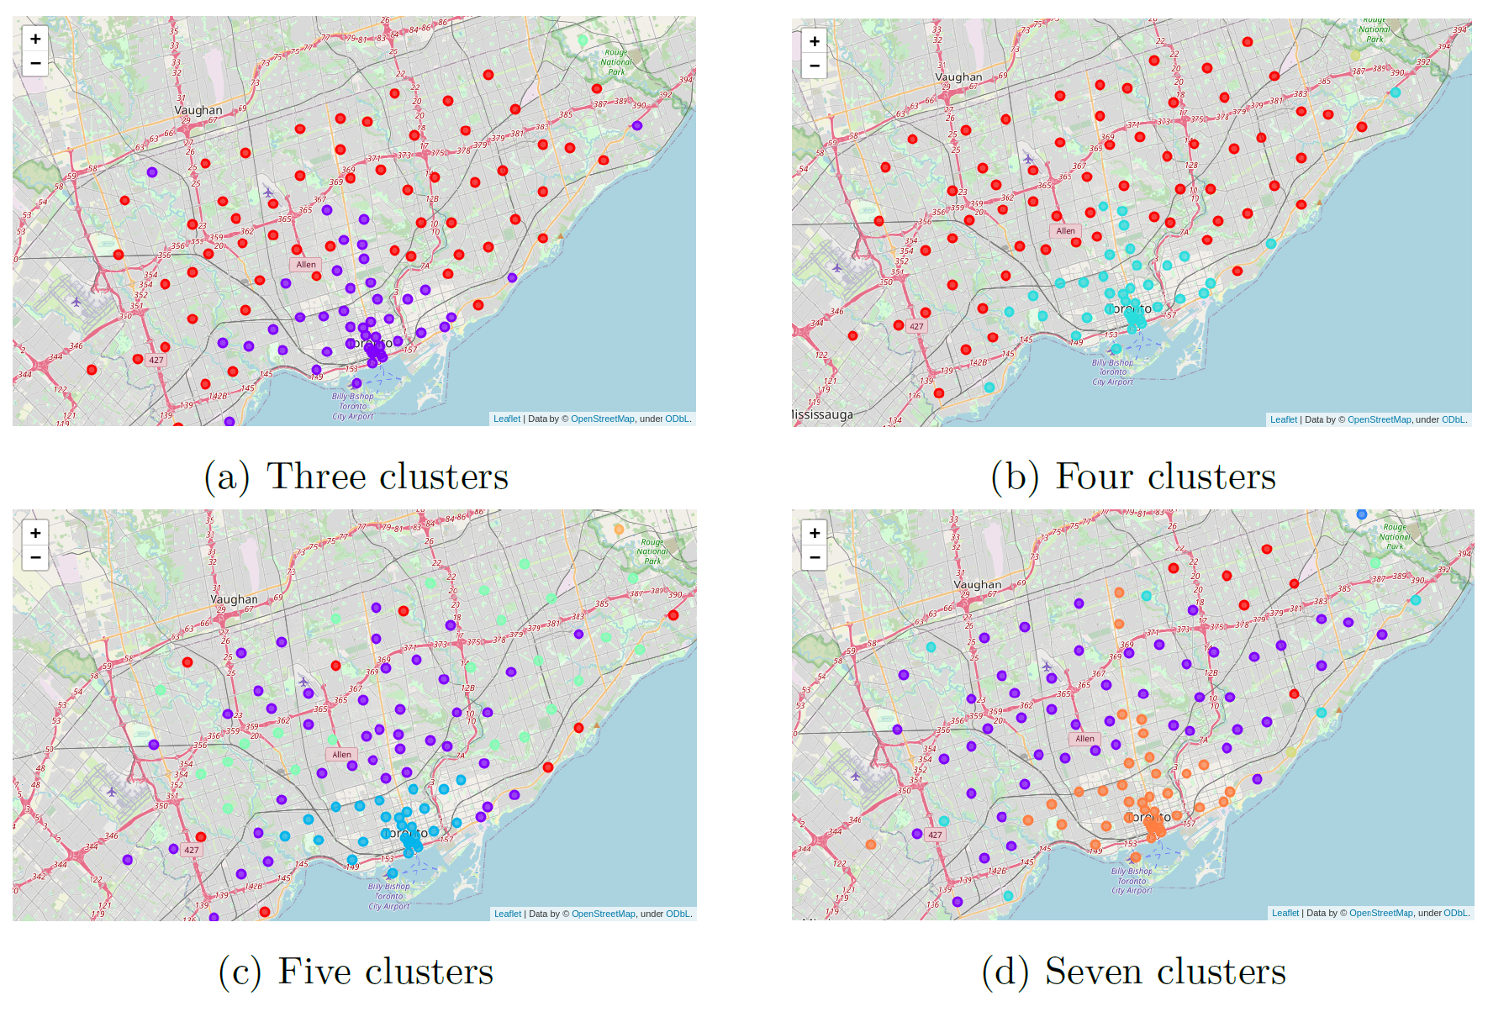
Spatial distribution of public venue clusters
K-means clustering by similarity of top 10 venues:
Distinct cluster around harbour
Clusters with shared similarity (siblings) in broad band from East to West Toronto.

Slide 6
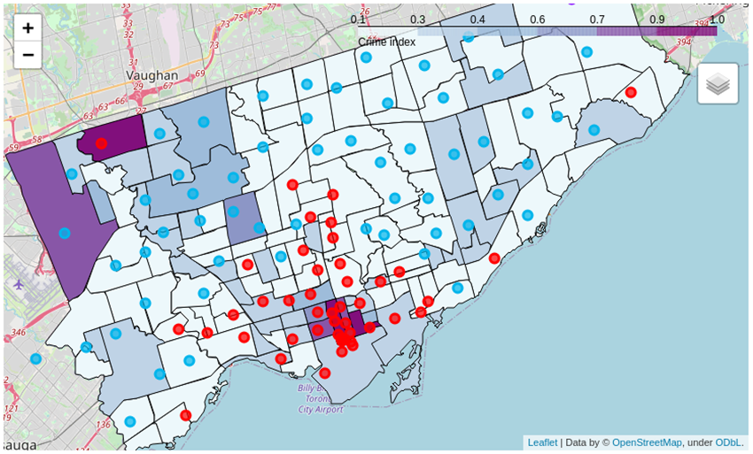
Mapping of crime to venue composition
Crime categories are consolidated in a single ‘crime index’
Harbour cluster correlates with high-crime
East-West cluster correlates with medium- and low-crime.

Slide 7
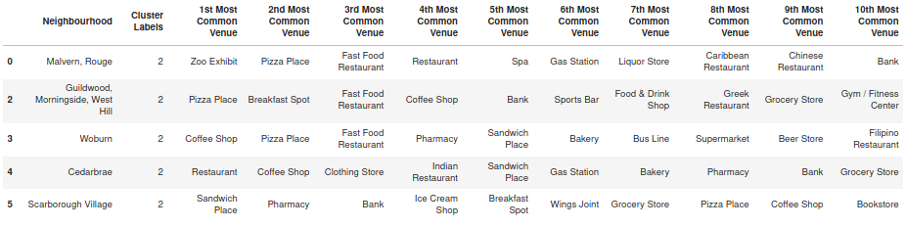
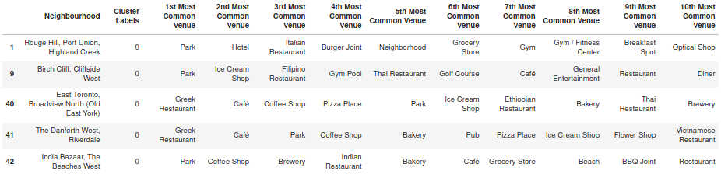
Clustering by venue is not very distinctive
Five neighbourhoods in the ‘East-West’ cluster: many restaurants and coffee shops.
v
Five neighbourhoods in the ‘Harbour’ cluster: many restaurants and cafés
(Presence of park is distinctive).

Slide 8
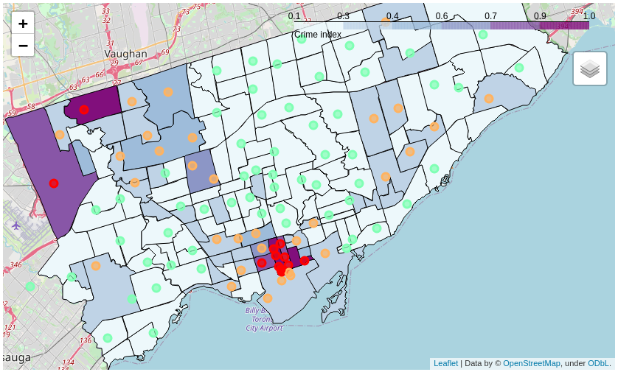
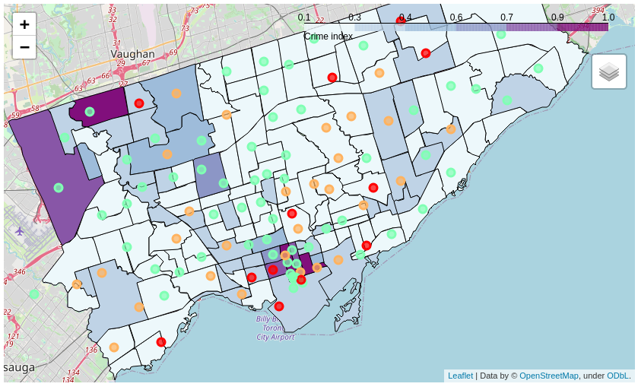
Automated prediction of crime by public venue composition
Clusters manually labeled to crime
Decision tree prediction
Cluster labels: red=high, yellow=medium, green=low
Area colours: purple=high, blue=medium, light blue=low

Slide 9
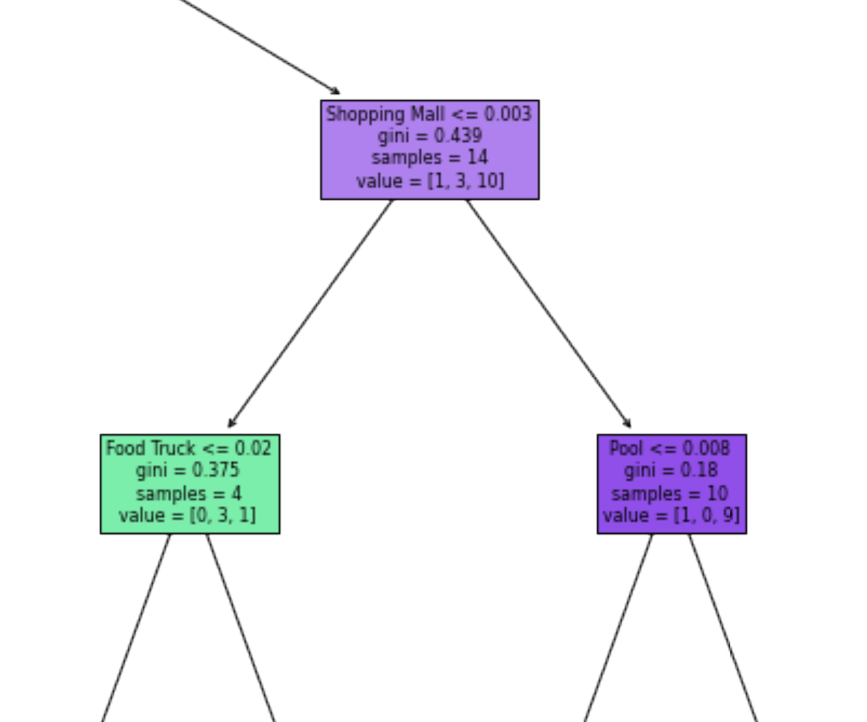
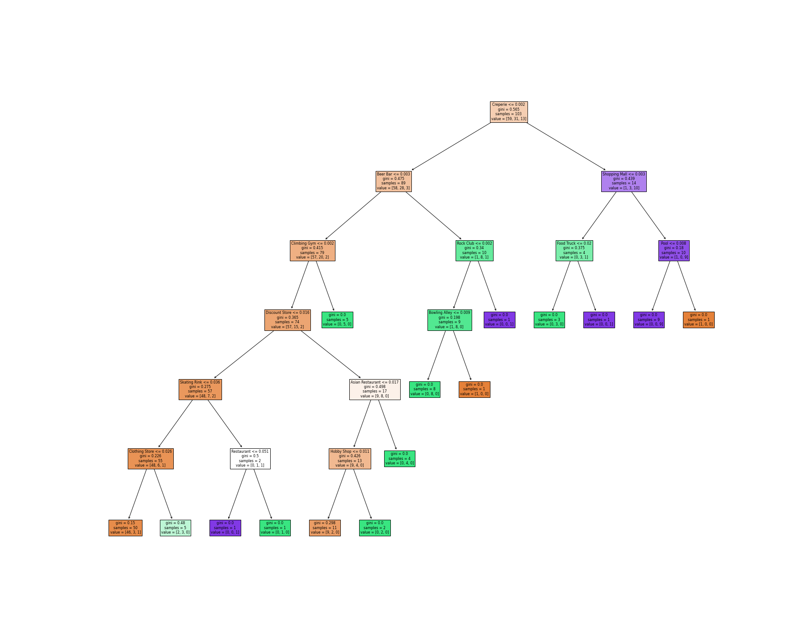
Modeling provides insight in classification
Explicit consequences of venue types for the crime classification may be taken into account in design and planning.
Accuracy | Decision tree | SVM
Overall | 0.76 | 0.57
Jaccard ‘high’ | 0.25 | 0.00
Jaccard ‘medium’ | 0.56 | 0.29
Jaccard ‘low’ | 0.77 | 0.59

Slide 10
Conclusions
Crime rate correlates with the public venue composition of neighbourhoods. K-means clustering can help obtain qualitative insight in this correlation.
Human interpretation of the correlation is not intuitive, so professional expertise (supported by modeling) is required to make predictions.
Decision trees can help make predictions but acceptable accuracy is only achieved for the most prevalent crime category in the training set.
The explicit nature of decision trees may also support a semi-qualitative approach that more strongly relies on professional judgement.
Therefore:
Machine learning indeed can be used to help city planners predict the effect of interventions. Caveats remain however, and professional expertise will still be required.

